Slide 1


Green Pace
Security Policy Presentation
Joshua Kelly
CS 405 Project Two
October 18, 2026
Notes:
My name is Joshua Kelly. In this presentation, I will describe the security policy of Green Pace and its applicability for software development and maintenance. I will focus on the threat ratings, coding standards, encryption, and access policies. Also, I will discuss the four container-bounds tests, how they can be done using automated tools, and areas in which the policy can be made more detailed. The goal is to lower security risks and verify the protections provided.

Slide 2

DEFENSE IN DEPTH
The policy covers everyone who builds or supports software
Protection includes secure code, access controls, and encryption
Testing and monitoring help when another protection fails
Notes:
Green Pace needs specific security requirements because security problems of its software can lead to the leakage of private information, loss of data or service disruptions. The policy applies to all employees who develop, deploy or support Green Pace software.
Defense in depth implies the usage of several layers of protection. For instance, parameterized queries protect the system from SQL injections. Permissions of database accounts limit what an account can access and logs help to trace suspicious activity. Green Pace uses logs of the operating system, firewall, and anti-malware applications. Secure coding and application testing also contribute to the protection. Every layer of security reduces the risk of damage caused by the failure of another layer.

Slide 3
THREATS MATRIX
Coding / system rules | Severity | Likelihood | Cost | Priority | Level
STD 002, 004; SYS 002, 004 | High | High | Medium | High | 5
STD 003, 005, 010; SYS 005 | High | High | High | High | 5
STD 001, 008, 009; SYS 001 | High | Medium | Medium | High | 4
SYS 003: in-use encryption | High | Medium | High | High | 4
SYS 006: accounting | Medium | High | Medium | High | 4
STD 006: assertions | Medium | Medium | Medium | Medium | 3
STD 007: exceptions | Low | Low | Medium | Low | 2
Project One rates threats from 1 to 5. Level 5 is the highest. All 16 ratings are shown.
Notes:
The ratings of the following threats were taken from the Project One policy. Severity describes the potential damage the threat can cause. Likelihood describes how likely it is for the threat to occur. Remediation cost describes how complex it is to implement the needed fixes. Priority indicates how urgent the security policy declares the threat. Threat ratings range from one to five, where five is the highest.
Numeric overflow, unsafe strings, SQL injection, invalid memory access, and container-bounds are all threats with level-five ratings. Missing transport encryption, authentication, and authorization also get level-five rating.
Data conversions, pointers, initialization, storage encryption, processing protection, and accounting are level-four threats. Assertions are level-three, and exception handling is level-two. Lower threats also need to be fixed but higher threats should be addressed first. The next table groups standards with similar ratings.

Slide 4
10 PRINCIPLES
Security principle | Related policy standards
1 Validate input data | STD 1, 2, 3, 4, 6, 8, 10
2 Address compiler warnings | STD 1, 5, 8, 9, 10
3 Include security in the design | No coding rule listed; SYS 1–6
4 Keep it simple | STD 5, 7, 9
5 Deny access by default | No coding rule listed; SYS 5
6 Give only the access needed | No coding rule listed; SYS 5
7 Check data sent to other systems | STD 3, 4
8 Use multiple security layers | STD 4, 5, 7, 8
9 Review and test the software | STD 2–10
10 Follow a secure coding standard | STD 1, 2, 4, 6, 7, 9, 10
STD 1–10 are the coding standards. Some principles still need matching coding rules.
Notes:
Ten security principles give the justification of why Green Pace created certain coding standards. Input validation is related to several standards because the outside information can cause problems with numeric data, strings, SQL queries and containers' boundaries. Compiler warnings are used for finding the possible mistakes in the code.
Simplification of the code simplifies the analysis of memory management, exception handling and initialization. Validation of data which is sent to other systems prevents unsafe strings and SQL injections. The principle of defense in depth is applied when implementing multiple protections. Quality assurance involves code reviews and tests.
There are also gaps in the policy. Such principles as secure design, default deny, and least privilege relate to system requirements but there are no mappings for them in the list of coding standards. Green Pace needs to address this issue.

Slide 5
CODING STANDARDS
Standard | Required practice | Level / priority
001 Data type | Use correct types and check conversions | 4 / High
002 Data value | Check limits before doing calculations | 5 / High
003 String correctness | Use safe strings and check their length | 5 / High
004 SQL injection | Use query parameters for outside input | 5 / High
005 Memory protection | Manage memory and object lifetimes | 5 / High
006 Assertions | Assert assumptions and validate input | 3 / Medium
007 Exceptions | Catch exceptions by reference | 2 / Low
008 Pointer safety | Check pointers before using objects | 4 / High
009 Initialization | Set initial values before reading them | 4 / High
010 Container bounds | Check indices before accessing elements | 5 / High
Address Level 5 first, then 4, 3, and 2. Consider the risk and the cost of fixing each issue.
Notes:
Green Pace coding standards make ten security principles applicable for developers.
The first standard addresses appropriate selection of data types and conversion verification. The second standard checks limits before performing the calculations. The third standard concerns safe strings and length checks. The fourth standard requires the use of prepared statements and bound parameters.
The fifth standard concerns memory management and lifetime of objects. The sixth standard uses assertions for internal assumptions while leaving input validation enabled. The seventh standard requires exception handling by reference for the classes. The eighth standard checks validity and lifetime of objects through pointers. The ninth standard requires initial values assignment before reading them. The tenth standard checks the indices of containers before accessing them.
Green Pace should address level-five threats first, then level-four, then level-three, and finally level-two threats. Fixing cost affects the planning of actions but high complexity does not affect the severity of a threat.

Slide 6
ENCRYPTION POLICIES
At rest: encrypt saved confidential data and backups
Keep encryption keys separate from the data
In flight: use approved protocols like TLS and valid certificates
In use: use memory encryption and trusted environments when risk calls for it
Limit unencrypted copies in logs, temporary files, and crash dumps
Notes:
Encryption policy of Green Pace involves data at rest, data in flight and data in use.
Data at rest is any information that is saved in files, databases and backups. Confidential data requires approved encryption while encryption keys should be handled separately.
Data in flight is information that is transferred between users, applications, and servers. Any sensitive information requires encrypted transmission, for instance, TLS protocol and confirmation of identities of communicating parties.
Data in use is information that is currently being processed. Depending on the threat, the policy requires confidential computing environment with hardware encryption and trusted execution environment. In case it is possible, Green Pace should verify the environment before giving data or encryption keys to the application.
Also, unencrypted copies in logs, temporary files, and crash dumps should be limited. Those steps decrease exposure but do not provide encryption of information in use. Missing transport encryption is a level-five threat, while the other two types are level-four threats.

Slide 7
TRIPLE-A POLICIES
Authentication: verify identity and use stronger logins when needed
Authorization: deny access by default and give only needed permissions
Accounting: protect logs showing who did what and when
Log sign-ins, new accounts, permission changes, database changes, and sensitive file access
Notes:
Triple-A refers to authentication, authorization, and accounting.
Authentication identifies the user or service. Green Pace requires the usage of unique and strong passwords, while in case of threat, multifactor authentication should be implemented.
Authorization defines what an authenticated account is allowed to do. Accounts should have minimum privileges and the access should be granted only when explicitly needed.
Accounting keeps a record of all actions. The logs should contain who did something and when he or she did it. These events include logins, account creations, permission modifications, database modifications, and accesses to the sensitive files. Also, the logs should be protected from modification.
Authentication and authorization are both level-five threats. Accounting is a level-four threat since it makes the investigation of problems harder in case of missing or inaccurate logs. AD groups and LDAP/LDAPS can help with consistent access management for development tools.

Slide 8
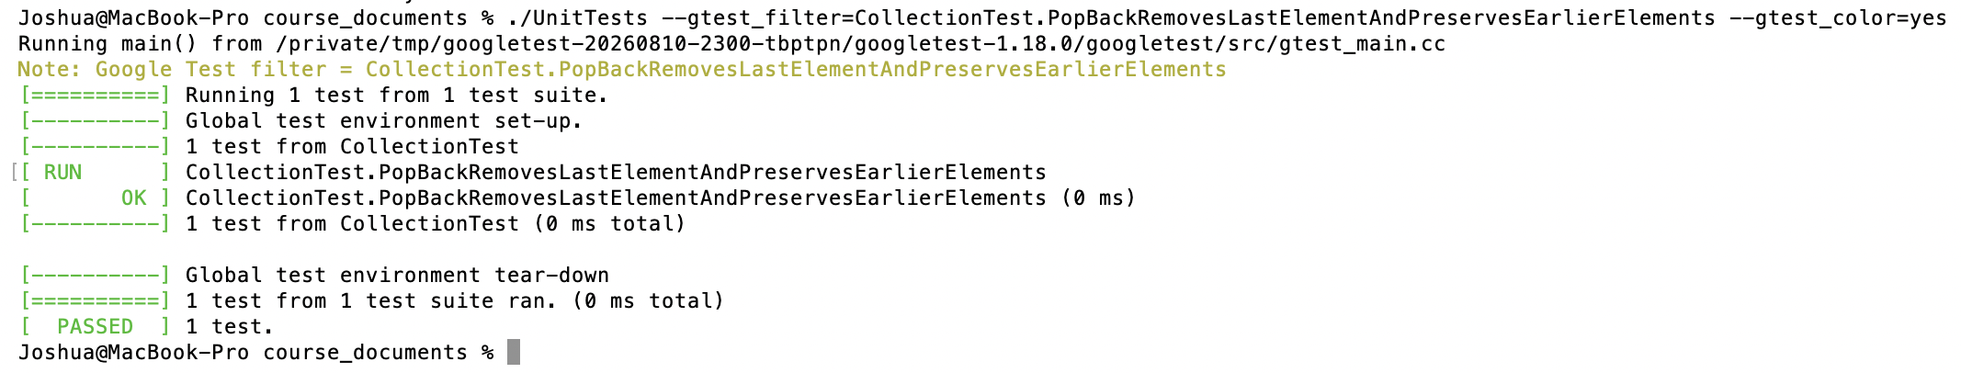
Does pop_back() preserve earlier elements?
Positive test: remove the last element and check the rest
Test: PopBackRemovesLastElementAndPreservesEarlierElements
Start with 10, 20, 30. Remove 30. Two elements remain.
EXPECT_EQ(10, collection->at(0));
EXPECT_EQ(20, collection->at(1));
Result: passed in the saved Module Four output
Notes:
This positive test, PopBackRemovesLastElementAndPreservesEarlierElements, checks whether removing the last element preserves the earlier elements. It supports coding standard ten, which concerns container bounds. The test starts with ten, twenty, and thirty, removes thirty, and confirms that two elements remain. It then verifies that at(0) returns ten and at(1) returns twenty. The Google Test screenshot shows that the test passed. Additional testing could cover a vector with one element and the application's access-checking functions.

Slide 9
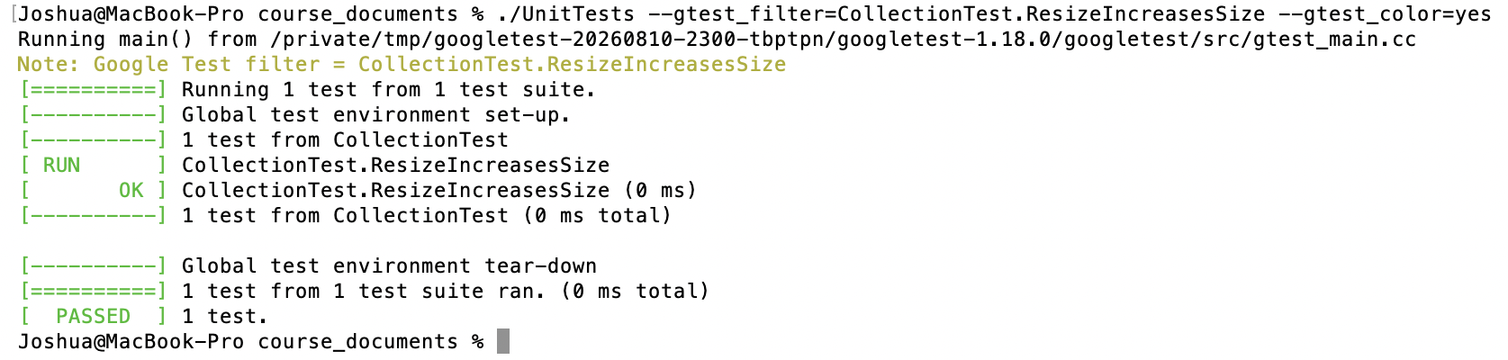
Does resizing a vector larger increase its size?
Positive test: vector grows from 5 elements to 10
Test: ResizeIncreasesSize
Operation: resize(10)
Expected result: vector size becomes 10
Actual result: Google Test passed
Notes:
The second positive test verifies that resizing a vector larger correctly changes its size. The test begins with five elements, resizes the vector to ten elements, and confirms that the new size is ten. Google Test reports the test as passed, showing that the resize operation behaved as expected. This test does not prove every aspect of safe access after resizing, so additional testing could verify preserved values, newly created elements, and behavior when reallocation occurs.

Slide 10
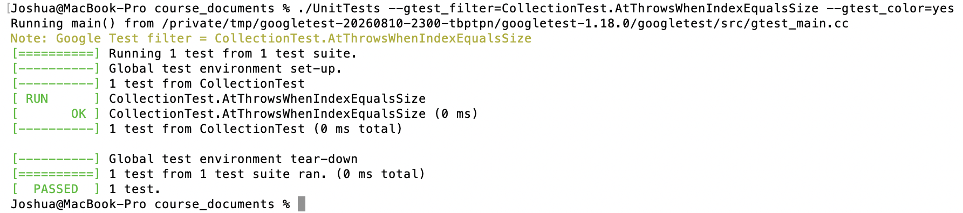
Does at() reject an invalid index?
Negative test: an index equal to size is out of bounds
Test: AtThrowsWhenIndexEqualsSize
With 5 elements, only indices 0 through 4 are valid
EXPECT_THROW(collection->at(collection->size()),
std::out_of_range);
Result: passed in the saved Module Four output
Notes:
This negative test, AtThrowsWhenIndexEqualsSize, checks an index equal to the vector's size. With five elements, only indices zero through four are valid. The test calls at() with an index of five and expects std::out_of_range. The Google Test screenshot shows that the test passed, confirming that the expected exception was thrown. This test does not verify how the application handles that exception. Additional testing could cover an empty vector, a much larger index, and application error handling.

Slide 11
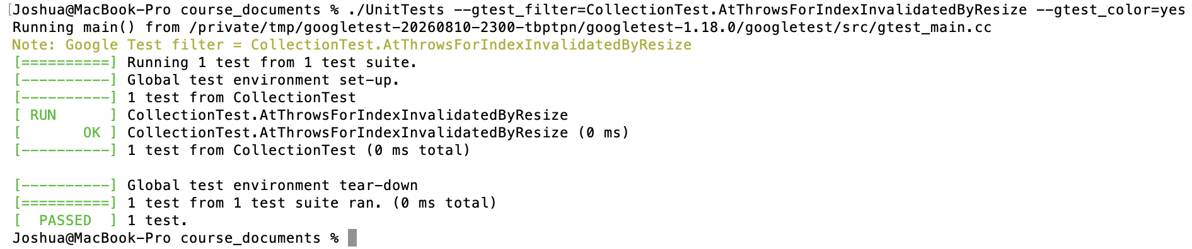
Does shrinking make an index invalid?
Negative test: shrinking makes an earlier index invalid
Test: AtThrowsForIndexInvalidatedByResize
at(4) works with 5 elements. After resize(2), it throws.
EXPECT_THROW(collection->at(4), std::out_of_range);
Result: passed in the saved Module Four output
More coverage could check an empty vector and error handling
Notes:
This negative test, AtThrowsForIndexInvalidatedByResize, checks an index that becomes invalid after shrinking the vector. The test starts with five elements and confirms that at(4) succeeds. After resize(2), only indices zero and one remain valid, so the test expects at(4) to throw std::out_of_range. The Google Test screenshot shows that the test passed. Index validity must be checked against the current vector size. Additional testing could resize the vector to zero and verify application error handling.

Slide 12

AUTOMATED SECURITY CHECKS
Check security during development and after release
Use the results to fix problems and improve the policy
Notes:
Security checks should be done at all stages of development and after release of the software. During planning, Green Pace should define the security threats and requirements. Then developers should incorporate them into the design and run automated checks during building and testing.
High-priority security threats should block the release until they are fixed or accepted in an approved exception. Signatures and integrity checks help protect the release process. After the deployment of the software, monitoring and incident response help find problems and develop improvements for the next release.
The access to those tools should be protected too. The use of AD groups and LDAP/LDAPS helps with consistent access management. The automated checks are especially helpful when someone reviews their results, is responsible for the found problems and implements the needed fixes.

Slide 13
TOOLS
Development stage | Checks and tools listed in the policy
Code / build | Compiler warnings; Parasoft C/C++test 2026.1
Static analysis | INT31, INT32, STR50, MEM50, MSC11, ERR61
Static analysis | EXP34, EXP53, CTR50; Amazon Q SQL detector v1.0
Test / before release | Google Test, composition analysis, integration, fuzzing
Release / monitor | Signing, integrity checks, monitoring, vulnerability review
The policy lists specific CERT checks. Scanners can still miss problems.
Fix high-priority issues before release or get an approved exception.
Notes:
The Project One defines the following automated tools and checks: Parasoft C/C++test version 2026.1 and checks for the coding standards: conversions, numeric overflow, unsafe strings, released memory, assertions, exception handling, null pointers, uninitialized values, and container bounds.
Also, the policy lists the Amazon Q SQL-injection detector. These are the tools defined in the policy. Listing of those tools does not imply that all of the scans were performed.
The tools are designed for different goals. The compiler warnings and static analysis help detect problems in the code. Google Test checks particular behavior during the test execution. Composition analysis checks the dependencies, and integration and fuzz testing check the application's behavior.
Signatures and integrity checks protect the release process while the monitoring helps to detect problems after deployment. However, all those tools require the assistance of code reviews and runtime tests because every tool has limitations.

Slide 14
RISKS AND BENEFITS
Acting now reduces injection, data corruption, and unauthorized access
Costs include fixing code, setting up tools, training, and testing time
Waiting leaves problems in place and makes later fixes harder
Scanners can miss issues, tools can be compromised, and tests have limits
Use several kinds of tests, protect build tools, and review exceptions
Notes:
The compliance with the policy can reduce serious security risks and help developers detect problems before release of the software. Also, it helps with creating the documentation that can be useful for investigation.
There are costs of compliance with the policy. The developers need time to fix the problems in the code, configure the tools, get the needed training, and perform the tests. Waiting might seemingly save time initially but it leads to the presence of known vulnerabilities and complications in fixing them after deployment.
The protections also have their limitations. Scanners might miss the security problems or report them incorrectly. The build tools might be compromised and several tests cannot prove the full security of the application. Confidential computing requires additional setup and might have compatibility issues.
Green Pace needs multiple types of testing, proper protection of development tools, and the documentation of all exceptions. Every exception needs risk analysis, measures to mitigate the threat, compliance plan and deadline, as well as CIO and CISO approvals or their authorized agents.

Slide 15
RECOMMENDATIONS
Fix Level 5 issues before release and improve test coverage
Assign owners, set fix deadlines, and give exceptions an end date
Define encryption settings, key rotation, and how long to keep logs
Add design rules and code checks for default deny and least privilege
Test boundary values, error handling, and application functions
Notes:
Firstly, I recommend to address level-five threats and improve container-bounds test coverage. Green Pace also needs to assign owner for every protection, define deadlines for addressing it based on priority, and provide expiration dates for approved exceptions.
In addition, the encryption requirements need more specifics concerning the approved settings and rotation/recovery process of the keys. Also, the accounting policy needs more details about the retention period of logs and their review frequency.
The secure design, default deny, and least privilege principles need to be supported by coding standards. The testing should be done for boundary values, object and iterator lifetime, error handling and actual functionality of the application.
These are recommendations for improving the policy. Green Pace needs to track them via risk management reports and annual policy review.

Slide 16
CONCLUSIONS
Follow all ten secure coding standards
Address Level 5 coding and system risks first
Check indices, use SQL parameters, and manage object lifetimes
Use encryption and Triple-A, then keep testing the protections
Notes:
Green Pace needs to comply with all ten coding standards and address the level-five threats first. The checking of container indices, parameterized SQL statements, and management of object lifetime can prevent common security threats in code. Encryption and Triple-A protect the data and access to it.
Unit tests show the behavior of particular operations. Automated checks and saved results help in continuous verifications of the mentioned protections.
Security also requires the regular follow-up. Monthly risk management reports and annual policy review of Green Pace will help with this purpose.

Slide 17
REFERENCES
Amazon Web Services. (n.d.). SQL injection. Amazon Q, Detector Library. https://docs.aws.amazon.com/codeguru/detector-library/cpp/sql-injection/
Google. (n.d.). Assertions reference. GoogleTest. https://google.github.io/googletest/reference/assertions.html
Software Engineering Institute. (2017). SEI CERT C and C++ coding standards. Carnegie Mellon University. https://www.sei.cmu.edu/library/sei-cert-c-and-c-coding-standards/
Notes:
The main references for this presentation are the SEI secure-coding material, providing context for the coding standards. Google's assertion reference explains the Google Test checks, and AWS provides the description of the SQL-injection detector which is included in the policy.

